Slide 1

Breast Cancer Classification Using Logistic Regression
In this project, we apply Logistic Regression with Gradient Descent to classify breast cancer tumors as malignant or benign. This presentation details our methodology and findings using a well-known dataset from the UCI Machine Learning Repository.

Slide 2
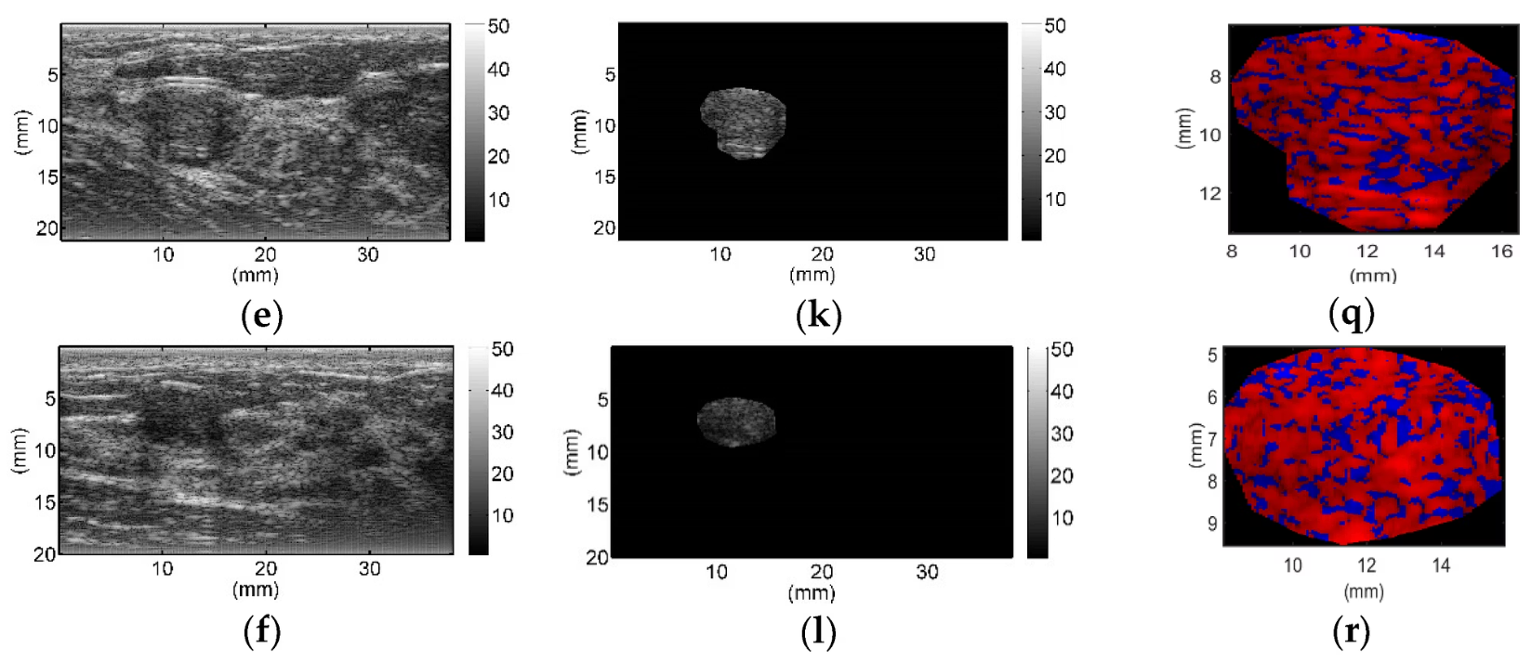
Dataset Overview
The dataset contains features computed from digitized images of a breast mass, providing crucial insights into the characteristics of the tumors.
Total records: 569 unique instances
Features: 30 numeric features, including measurements like radius, texture, perimeter, area, smoothness, compactness, concavity, concave points, symmetry, and fractal dimension. These are computed for the mean, standard error, and "worst" (largest) of each mass.
Target: Diagnosis (M = Malignant, B = Benign)

Slide 3
Preprocessing Steps
Target Encoding
Column Management
The categorical 'diagnosis' target variable was encoded into numerical format: Malignant (M) tumors were assigned a value of 1, and Benign (B) tumors were assigned a value of 0.
Irrelevant columns such as 'id' (a unique identifier) and 'Unnamed: 32' (an empty column) were dropped to streamline the dataset and prevent noise in the model.
Data Splitting
Feature Normalization
The preprocessed data was split into features (X) for model input and labels (y) for target prediction, preparing the dataset for training and testing phases.
All 30 numeric feature values were normalized using StandardScaler to ensure that features with larger numerical ranges do not disproportionately influence the model, leading to faster convergence during training.

Slide 4

Logistic Regression Overview
Logistic Regression is a fundamental statistical model used primarily for binary classification tasks. Despite its name, it is a classification algorithm that models the probability of a binary outcome. It works by fitting data to a sigmoid function, which maps any real-valued number into a value between 0 and 1, interpreting it as a probability.
Sigmoid Function:
The output, \sigma(z), represents the probability that the instance belongs to the positive class (e.g., malignant).

Slide 5
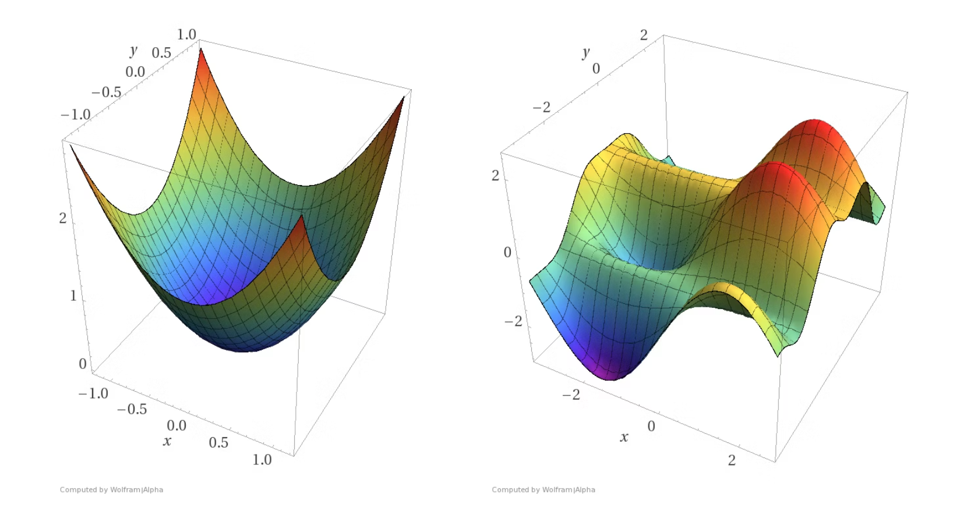
Gradient Descent Algorithm
Gradient Descent is an iterative optimization algorithm used to minimize the loss (cost) function of a model by finding the optimal parameters (weights and bias). It works by taking steps proportional to the negative of the gradient of the function at the current point.
Steps:
Initialize weights and bias: Start with random or zero values.
Compute predictions: Calculate the model's output for the current parameters.
Calculate gradient of loss: Determine the direction of the steepest descent.
Update weights: Adjust parameters in the direction that reduces the loss, using a learning rate (\alpha).
w := w - \alpha \cdot dw
b := b - \alpha \cdot db

Slide 6
Model Training and Evaluation
1
2
The Logistic Regression model iteratively updated its weights and bias using the Gradient Descent algorithm, aiming to minimize the cost function over multiple epochs.
The dataset was strategically split into an 80% training set and a 20% testing set. This division ensures that the model is trained on a substantial portion of the data while reserving unseen data for an unbiased evaluation of its generalization capability.
3
4
After training, the model's performance was rigorously tested on the unseen 20% of the data. This crucial step assesses how well the model predicts outcomes for new, unencountered instances, reflecting its real-world applicability.
Accuracy was chosen as the primary metric to quantify the model's effectiveness. It represents the proportion of correctly classified instances (both malignant and benign) in the test set, providing a clear indication of the model's predictive power.

Slide 7

Results and Accuracy
Our Logistic Regression model achieved a remarkable accuracy of over 90% on the test set. This demonstrates the effectiveness of Logistic Regression in classifying breast cancer tumors as malignant or benign based on the provided features.
The high accuracy indicates that the model effectively learned the underlying patterns in the data, making it a viable solution for this critical classification task. This performance underscores the potential of machine learning in medical diagnostics.
Correctly Classified
Incorrectly Classified

Slide 8



Conclusion and Future Work
Effective Classification
Further Improvements
Broader Impact
Logistic Regression with Gradient Descent proves to be highly effective for breast cancer classification, achieving high accuracy with a simple, interpretable model.
Model performance can be significantly enhanced by implementing advanced techniques such as L1/L2 regularization to prevent overfitting and feature selection methods like PCA or RFE to identify the most impactful features.
This work lays the foundation for developing more robust and reliable AI tools in medical diagnostics, contributing to earlier and more accurate detection of diseases.

